Slide 1

Welcome to the Year 3 Curriculum Evening
Times Tables in Year 3

Slide 2
Tonight’s aims
Share how Times Tables are taught in Year 3.
Provide you with ideas for how you can support your child to learn their multiplication facts at home.
Explain arrangements and expectations for the Year 4 Multiplication Tables Check.

Slide 3
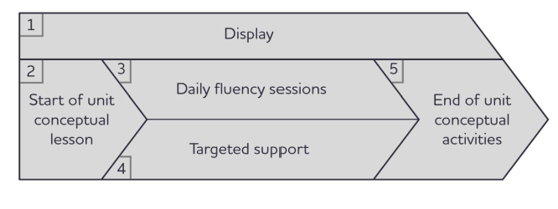

How do we teach Times Tables at OWPS
Number Sense programme
Coherently sequenced times tables programme across Years 3 and 4.
Daily 10-minute fluency sessions, plus 14 one-hour conceptual lessons spread through Year 3 and 4.
Recall of 36 core multiplication facts which provide the foundation for all written and mental multiplication and division.
In addition to the 36 essential facts, the programme teaches the 10, 11 and 12 times tables in preparation for the Y4 Multiplication Tables Check (MTC).

Slide 4
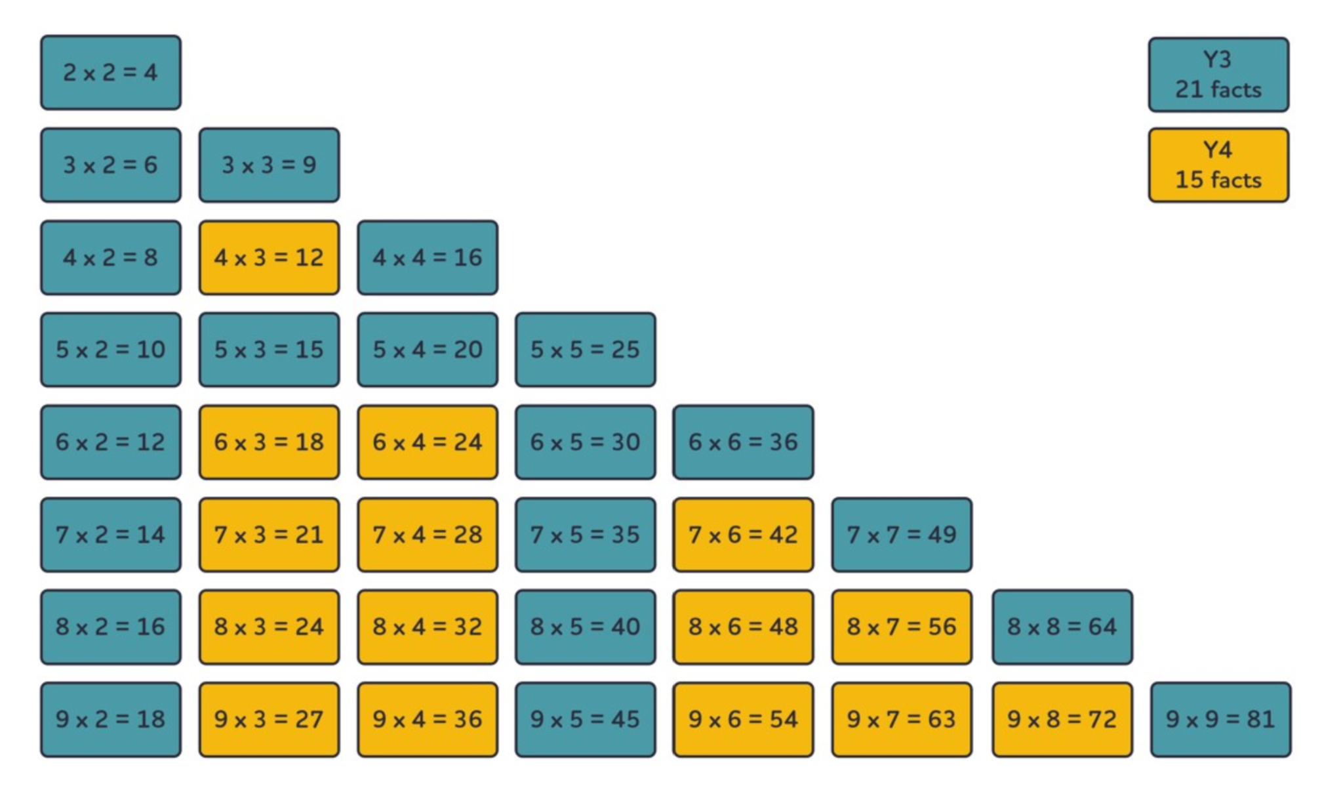
36 facts to learn
Notes:
LHS 2a The 36 essential facts on Vimeo

Slide 5
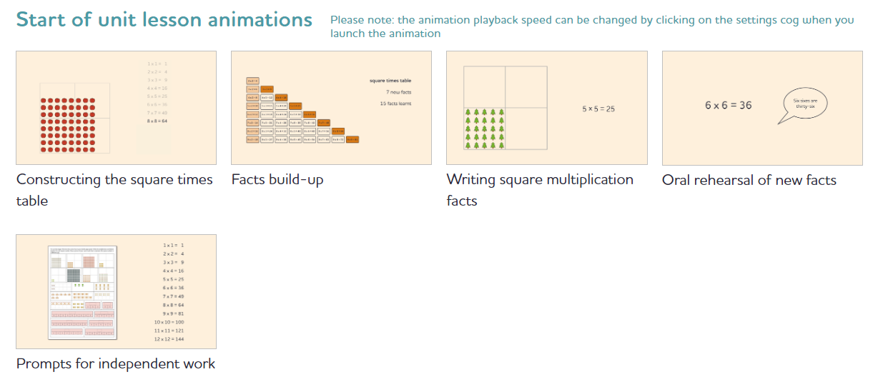
Start of Unit lesson
Notes:
Play some of the start of unit animations and narrate as we go
U4 6 Times Table | Number Sense Maths

Slide 6
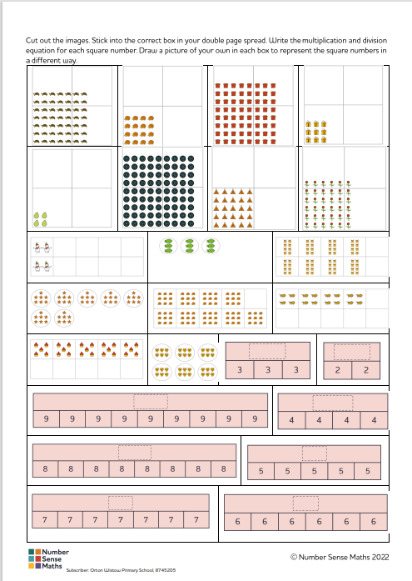
Start of Unit -
Independent Work

Slide 7
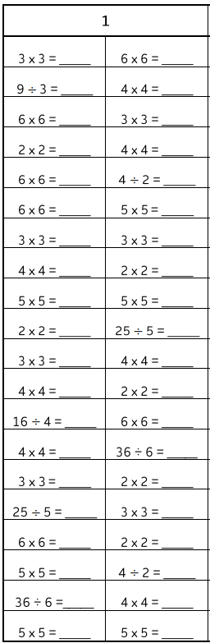
Daily Practice and
Targeted Support
Daily Practice
40 questions in 2 minutes.
Covers new facts, but also revisits those learnt previously.
Scores collected daily- used to inform children needing targeted support.
Targeted support group during assembly time weekly.

Slide 8
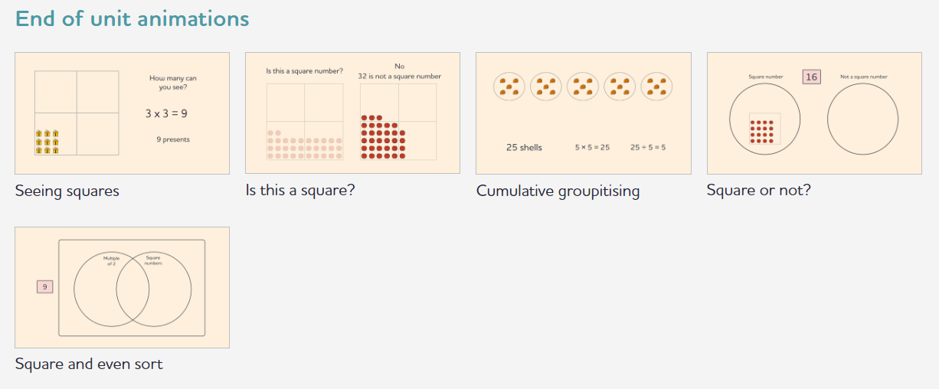
End of unit activities
Square Times Table | Number Sense Maths

Slide 9
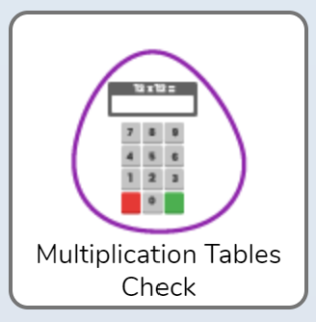
Times tables- helping at home
Times Tables Rock Stars (ttrockstars.com)
Purple Mash by 2Simple
Hit the Button - Quick fire maths practise for 6-11 year olds (topmarks.co.uk)
Daily 10 - Mental Maths Challenge - Topmarks
Notes:
Hayley

Slide 10
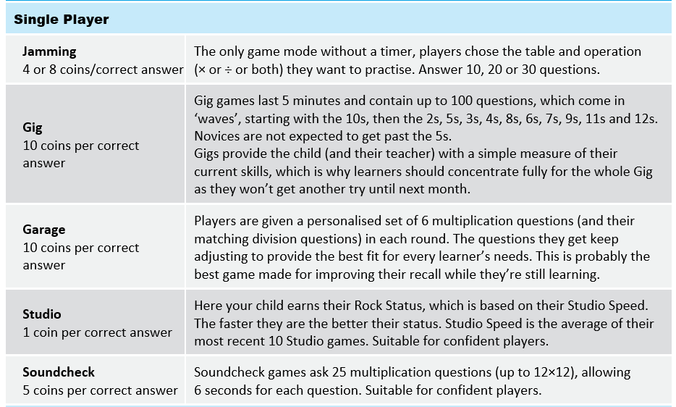
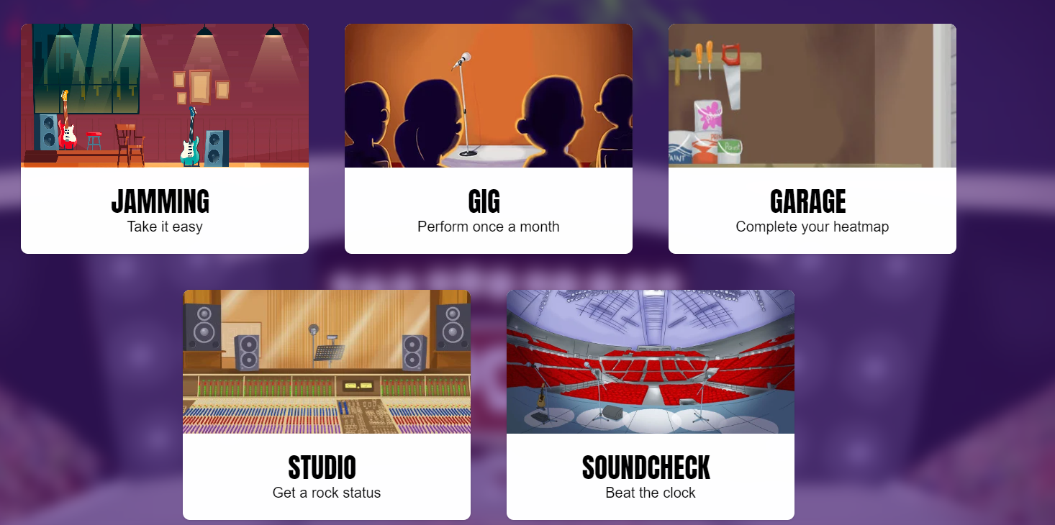
Times Tables Rockstars- which games to use?

Slide 11
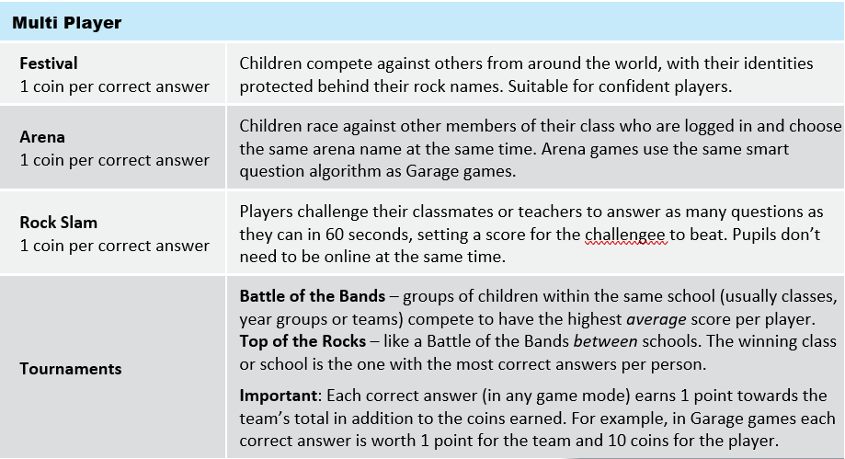


Slide 12
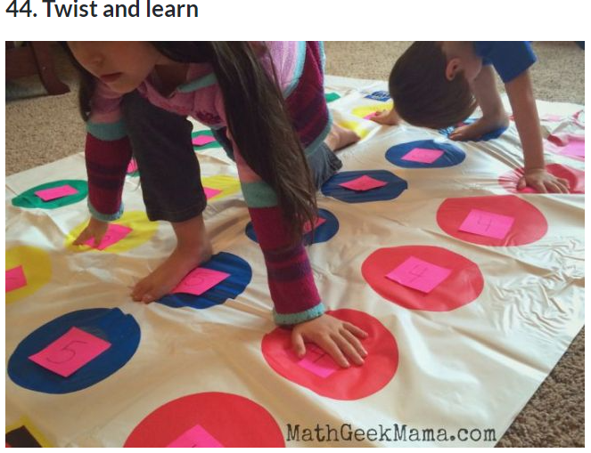
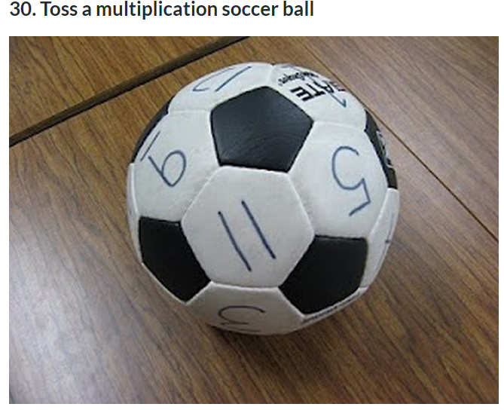
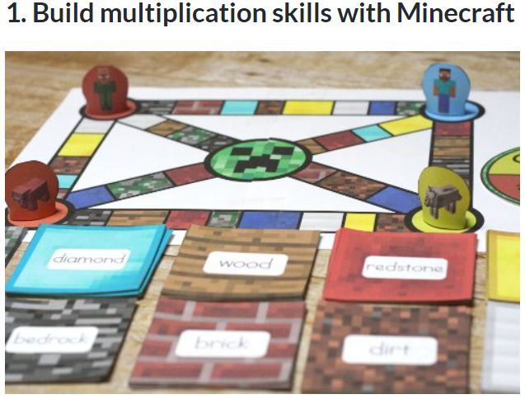
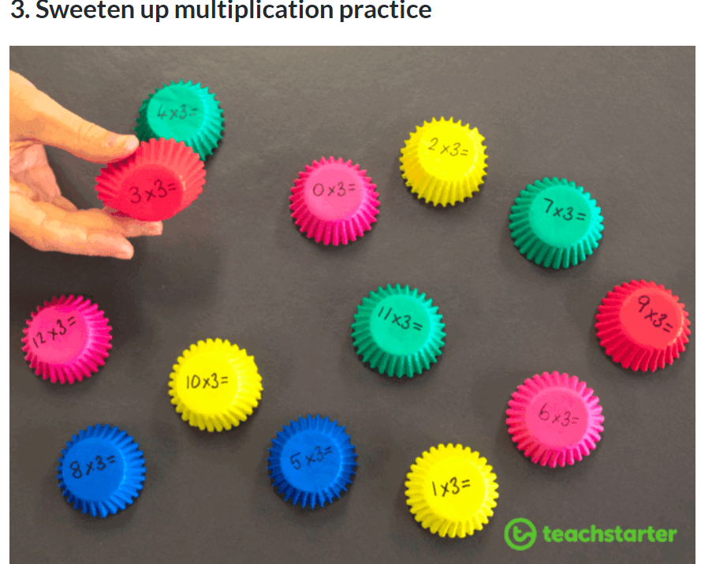
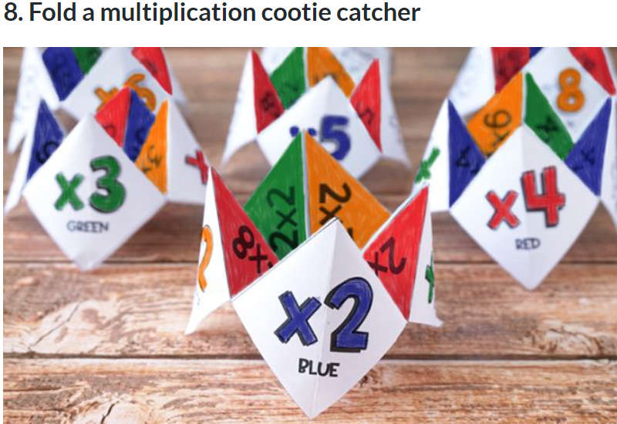
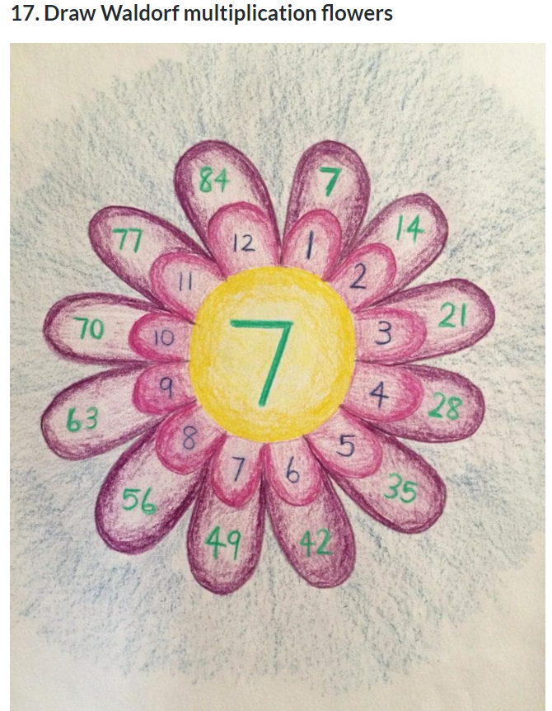
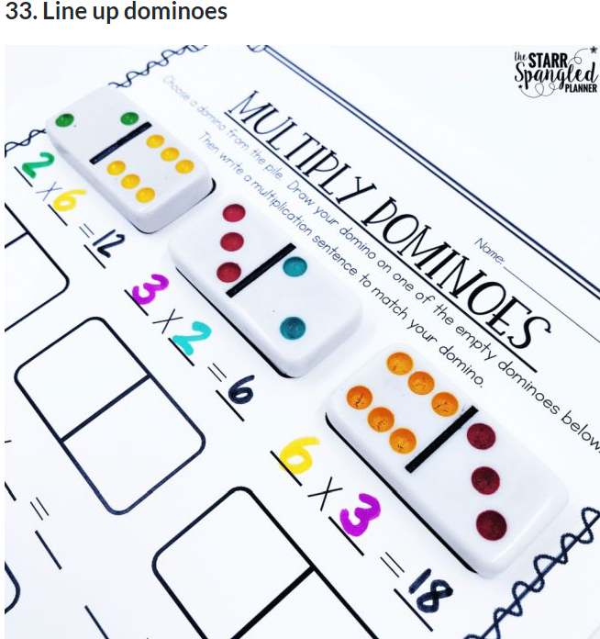
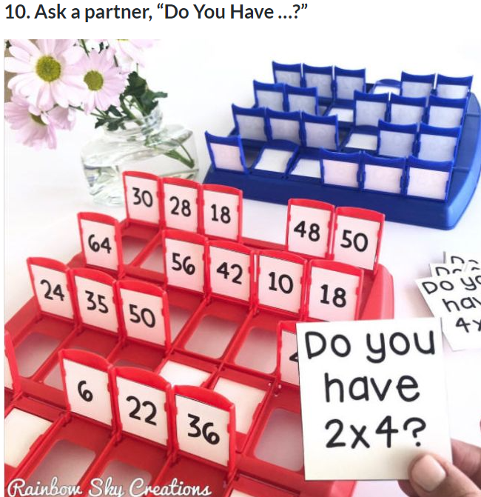
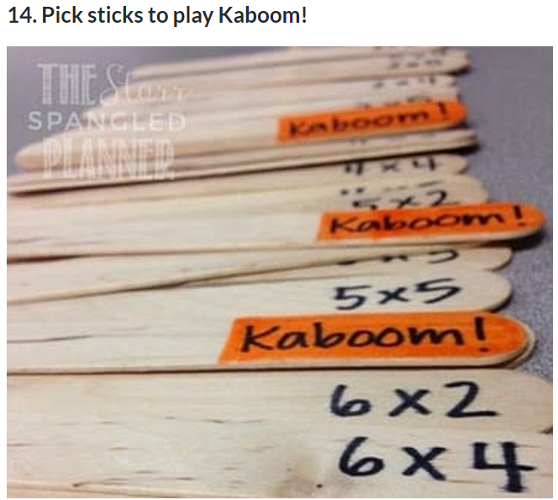
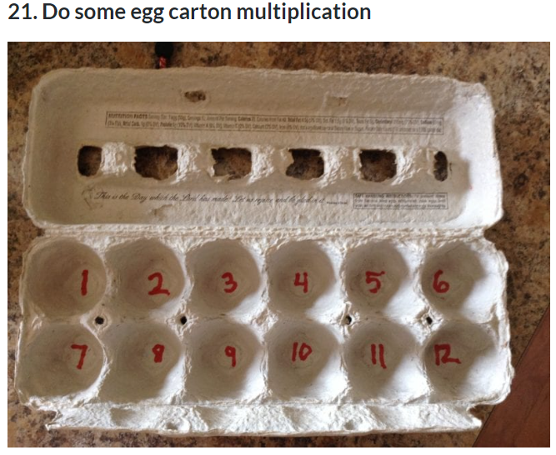
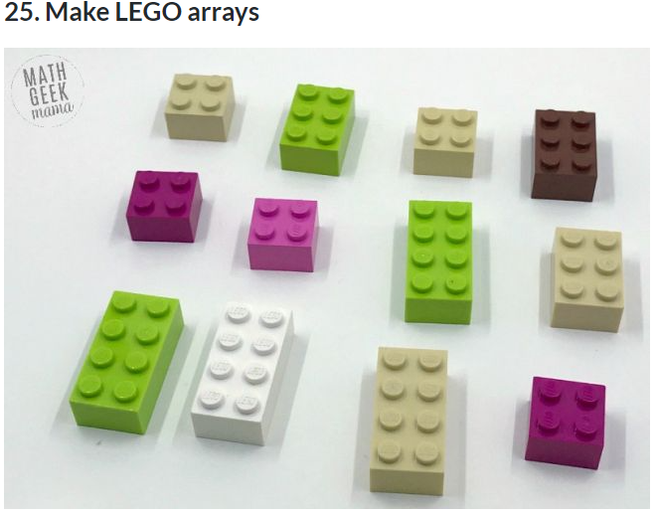
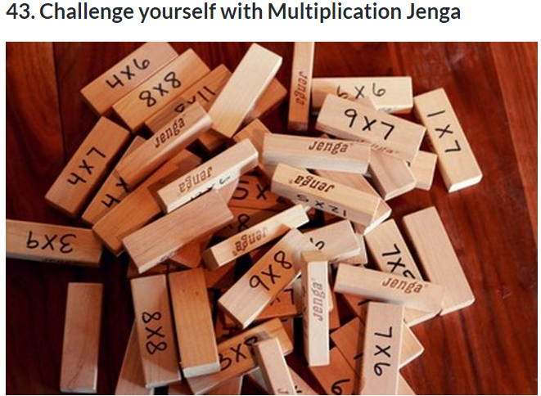
Multiplication Games
50 Fun Hands-On Activities To Teach Multiplication

Slide 13
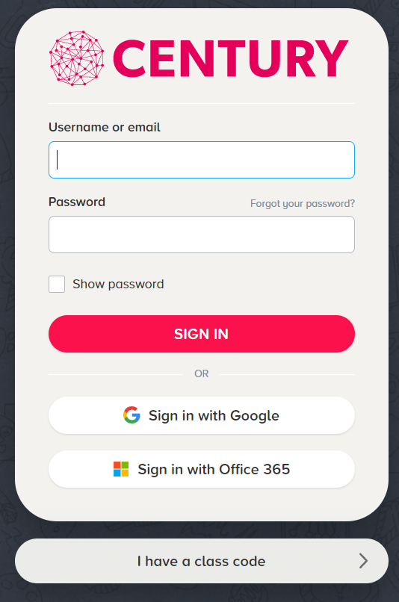
Century
CENTURY | Online Learning | English, Maths and Science
Log on here, using details in back of Reading Diaries

Slide 14
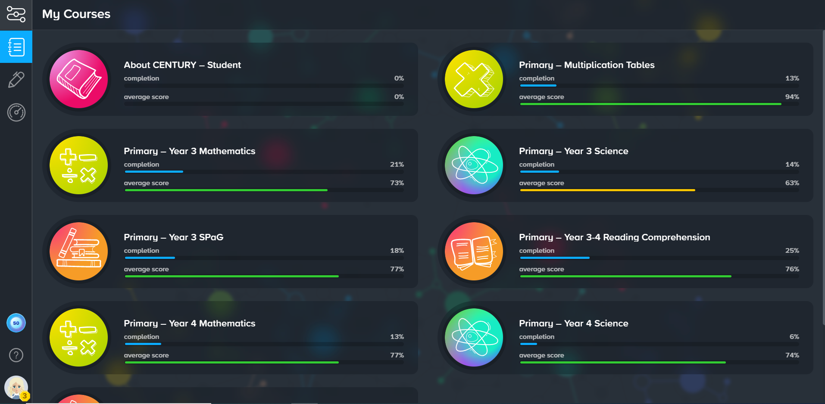
Times tables on Century

Slide 15
Multiplication Tables Check
Statutory Assessment for ALL children in Year 4.
Takes place in June.
Computer based assessment.
25 questions, 6 seconds to answer each question.
Government expectation is 25/25.
Regular learning and practise of times tables is essential.
Notes:
Hayley

Slide 16
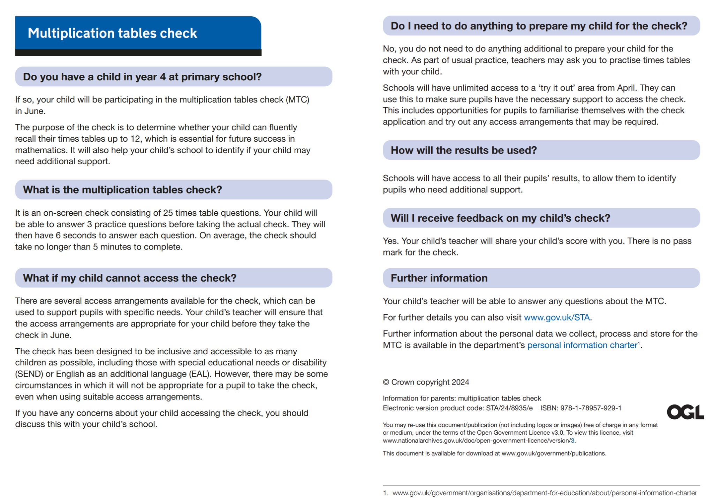

Slide 17
Any questions?

